Slide 1
Git

Slide 3
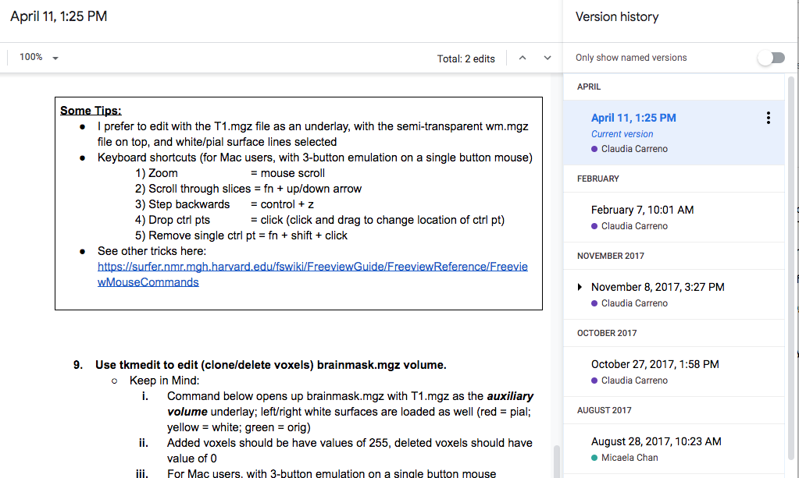
Version Control
Like track changes & version history
Microsoft Word
Changes are highlighted, and you know who did it (ideally)
Google-doc
All changes are recorded, and you can go back to see how things were like before a certain change.

Slide 4
Separate changes can be incorporated together

Slide 5
1. Setting up git
1.1 - Download git
1.2 - Configure git
Username & email
Line break
Text editor

Slide 6
2. Creating a repository > git init
2.1 – Create a directory in your Desktop
> mkdir ~/Desktop/workdir
> cd ~/Desktop/workdir
2.2 – Create a repository (stores the versions of your files)
> git init

Slide 7
3. Tracking Changes > git add, commit
3.1 – Adding new files/modification to staging area
> touch foo.txt
> git add foo.txt
3.2 – Saving these changes to the repository
> git commit –m “Add foo.txt to repo”
BONUS – Checking what has changed before add/commit
> echo hello >> foo.txt
> git diff
> git add –A
> git commit
> git log

Slide 8
File versions let us go back in time!
What is wrong with just using `my_script_version100.sh`?
Codes that worked last week don’t work anymore!?
Codes crashed after someone else changed it!?
(don’t murder them)
New lab member joins the lab, inherit a project started 4 years ago by an ex-lab-member……
Notes:
Give example from gitlab

Slide 9
4. Exploring History > git diff & show
4.1 – Difference between current file and N commit ago
> git diff HEAD
> git diff HEAD~1
> git diff efakb1
4.2 – What was done in ____ commit?
> commit show HEAD~1 foo.txt
Identifer is different for every commit/repo, use git log to check.

Slide 10
5. Reverting to a previous commit > git checkout
5.1 – Going back to a specific version of a file
> git checkout HEAD~1 foo.txt
> cat foo.txt
> git checkout HEAD foo.txt
5.2 Going back to an entire commit - Detached HEAD (CAUTION)
> git checkout HEAD~1
IF you checkout a previous commit without first committing your current state, then anything not committed would be lost!!!
> git checkout HEAD

Slide 11
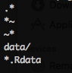
6. Telling git to ignore certain files .gitignore
Sometimes we don’t want git to track a certain type of files
Temporary files (e.g., bla.m~, .bla.txt)
Big data files (e.g., huge_matrix.mat, pca_result.Rdata)
OS files (e.g., .DS_Store)
Use a .gitignore file
> touch ignore_this.txt
> echo ignore_this.txt >> .gitignore
> git add ignore_this.txt
NOTE: .gitignore can ignore an entire subdirectory.
Here is how a typical .gitignore file might look like:
This will now tell Git to not track ignore_this.txt

Slide 12
BREAK
This ends the brief intro to version control function in git.
There is a lot more, your preferred search-engine is your friend
Next up:
Github and its cousins to help your share your codes

Slide 13
Github and other remote hosts
A remote server that hosts repositories for free
Some other choices:

Slide 14


7. Putting codes on Github make a repo
7.1 – Create a remote repository
Go to https://github.com/<username>
Click Repositories tab
Click
Enter workdir as the Repository name, click
You now have a remote repository, but its empty!
An empty repo on github would have some instructions on how to populate it

Slide 15
7. Putting codes on Github > git remote add & push
7.2 – Push an existing repository from your local computer
> cd ~/Desktop/workdir
> git remote add origin https://github.com/<username>/workdir.git
> git push –u origin master
BONUS – SSH keys can be used for authentication instead of passwords.
https://help.github.com/en/enterprise/2.15/user/articles/adding-a-new-ssh-key-to-your-github-account

Slide 16

8. Getting a repository from Github fork & git clone
8.1 – Fork a repository (remote → remote)
Fork means copying someone's Github repo into your Github
Click the Fork icon near the top right corner
And then you should be redirected to a copy of the same repository in YOUR Github account
Now you should have a git_github_workshop repo in your github

Slide 17
8. Getting a repository from Github fork & git clone
8.2 – Cloning a repository (remote → lcoal)
Clone means you copy a remote repo onto your local computer
Clone the forked repository onto your local computer:
> git clone https://github.com/<username>/git_github_workshop.git ~/Desktop/git_github_workshop

Slide 18
9. Collaborating
9.1 – Setup a fake collaborator
Clone repo into a separate directory
> git clone https://github.com/<username>/workdir.git ~/Desktop/workdir_fake_collab
Make changes as fake collaborator and push to Github
> cd ~/Desktop/workdir_fake_collab
> touch foofoo.txt
> git add foofoo.txt
> git commit -m "Add foofoo.txt"
> git push origin master
Check what is on Github and workdir_fake_collab
Check what is in the original workdir

Slide 19
9. Collaborating > git fetch & git pull
9.2 – Implement the changes your fake collaborator made
Fetch the changes your fake collaborator pushed to Github onto your local computer.
> cd ~/Desktop/workdir
> git fetch
This does not change the files in your directory, but now you can check what your collaborator has changed
> git diff master origin/master
If you decided these are changes you want, you can pull the changes
> git pull

Slide 20
9. Collaborating Collaborating on Github
Adding collaborators in your Github repository
Click Settings
Click Collaborators and add them (they need to be on Github)
More advance way to collaborate (won't cover in detail)
Fork a repository you want to make changes
Clone it to your local computer
Make changes, add, commit & push it to your forked repo
Make a Pull Request in the original repository so the original owner can merge your request.
Ask me later ☺

